Slide 1
Where is my carbon?
Autodesk Forge 2022 Hackathon Showcase
Team HackOverflow from Affiliated Engineers, Inc.

Slide 2
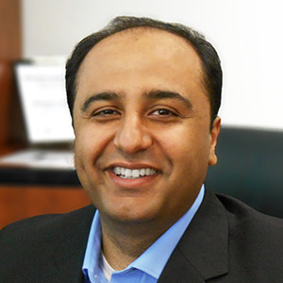



Arif Hanif
Eric Berridge
Meet the Team
Team Lead/Project Manager
Software Engineer
Team HackOverflow
Nick Khoury
Nick Smith
Software Engineer
Building Performance Consultant

Slide 3
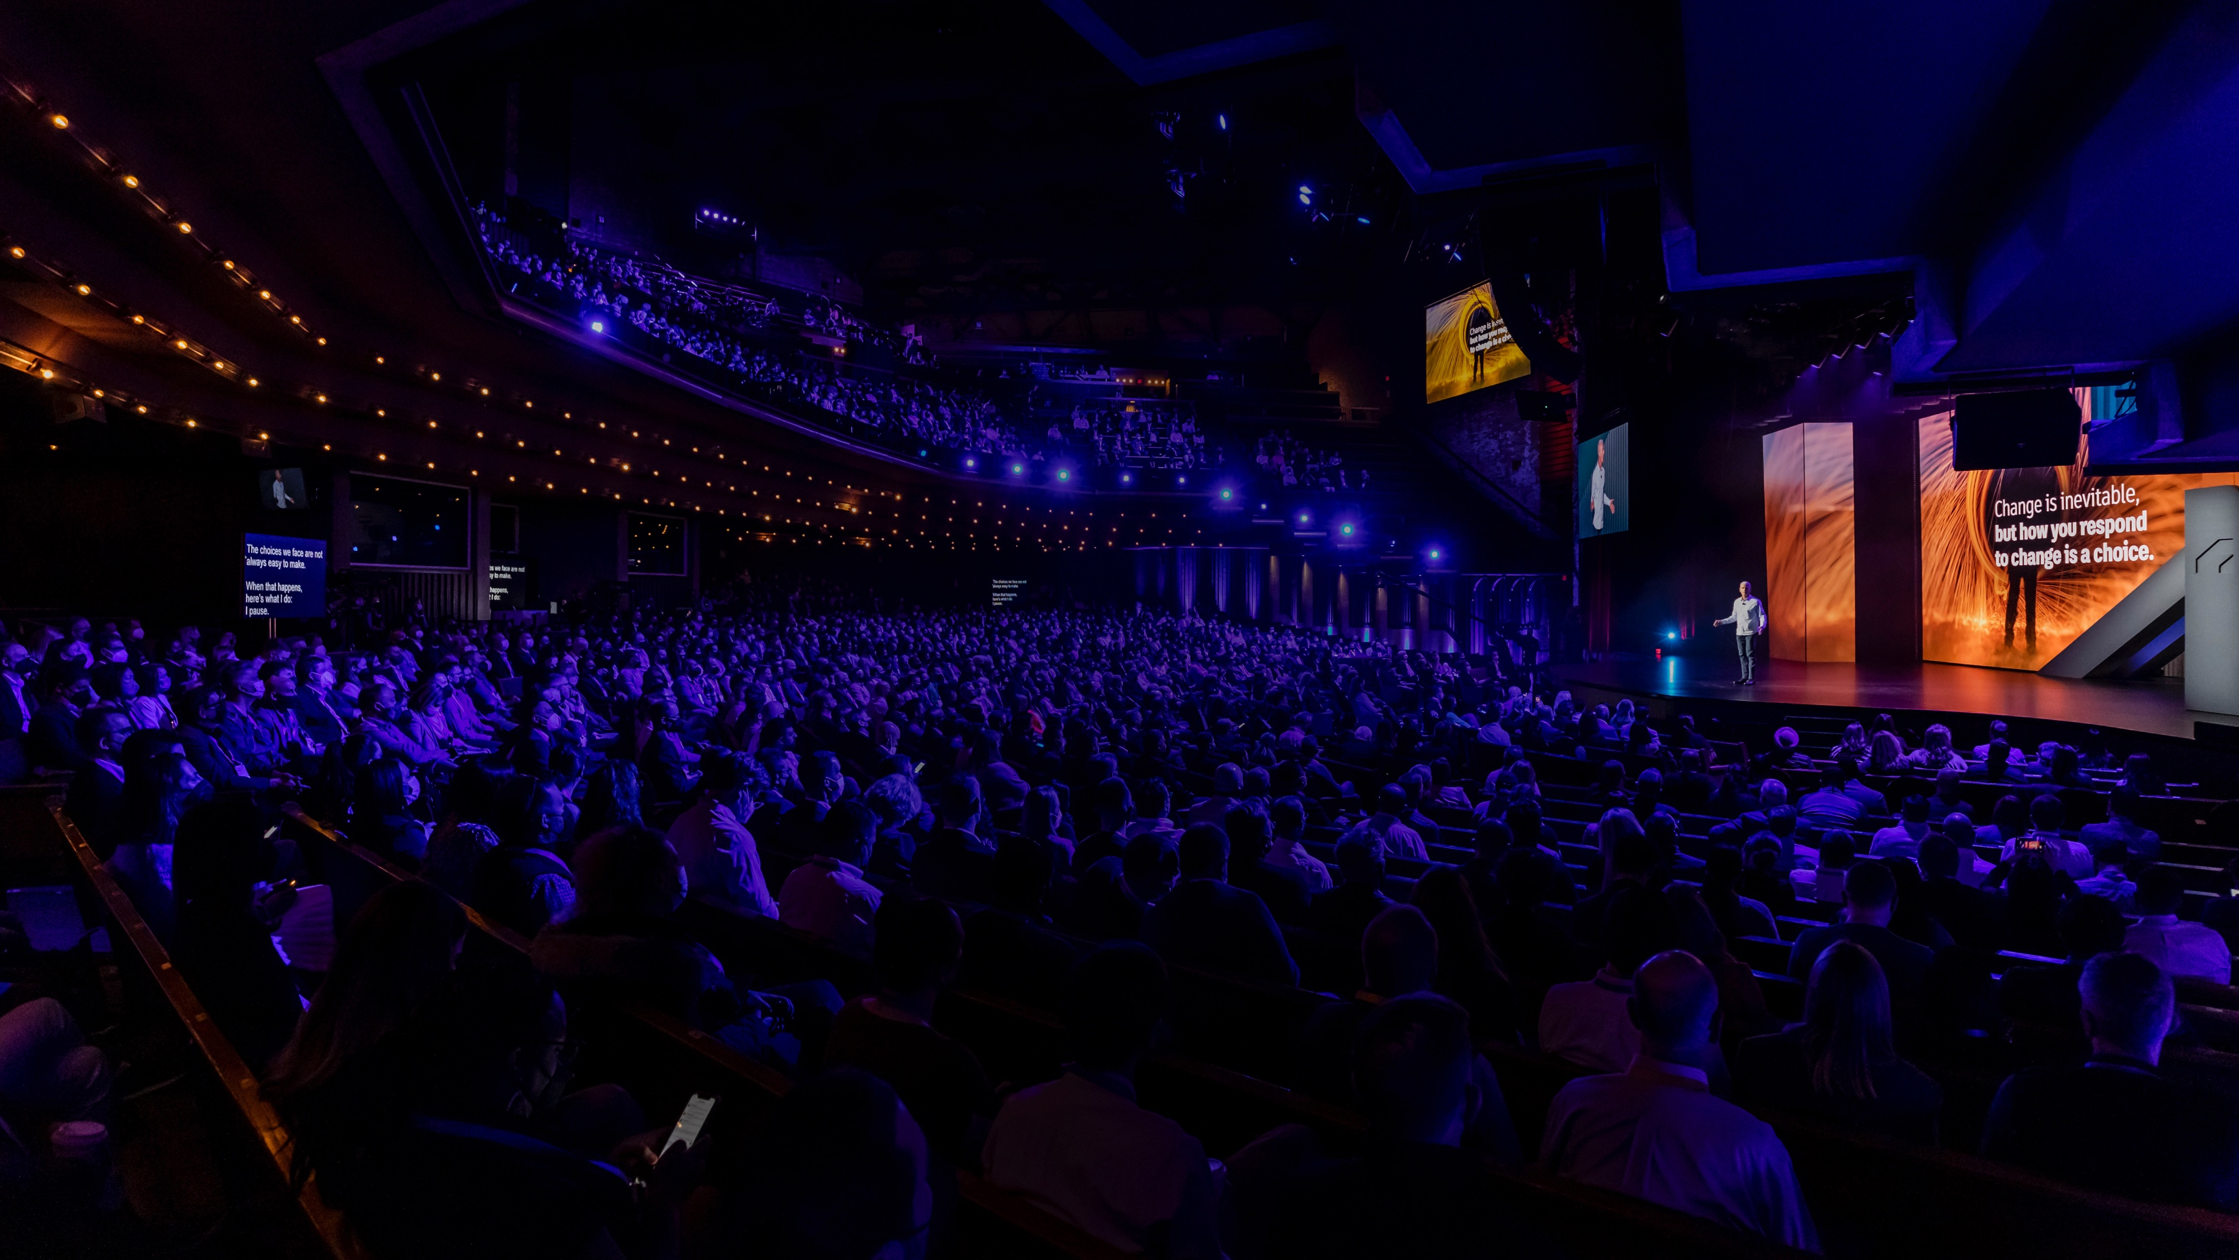

Challenge
Show me the Data!
The Forge Data APIs enable you share the right data with the right teams at the right time. As a developer, you can access the underlying cloud APIs to power your custom apps and workflows. We intend to explore creative ways to make data work for you and your teams.
Hack the planet!
The Forge toolbox enables you to deliver insights to realize more sustainable outcomes for the future. Use Forge APIs to:
build dashboards focused on increasing your sustainability score
connect materials databases
calculate carbon footprints and more!
Unlock data from Fusion, Revit, and other tools to create a holistic sustainable solution.
Notes:
For the love of the 3D game!
Get creative with the three.js library and build a fun game we'll never want to put down. Bonus points will be awarded for using the Forge Viewer.
Show me the Data!
The Forge Data APIs let you share the right data with the right teams at the right time. As a developer, you can access the underlying cloud APIs to power your custom apps and workflows. We want to see the creative ways you can make data work for you and your teams.
I feel the need, the need for Digital Twin!
How smart or innovative is your digital twin? Is it something no one has ever seen before? Bonus points will be awarded for using the Data Visualization extensions for the Forge Viewer, and for making sure your digital twin is as environmentally friendly and sustainable as possible.
Task automation is a state of mind
How many tedious, manual processes can be automated? Use the Forge Design Automation APIs to help you automate repetitive tasks, freeing up time and energy to focus on more complex workflows.
There is no place like ACC
Autodesk Construction Cloud connects workflows, teams, and data at every stage of construction to reduce risk, maximize efficiency, and increase profits. If you're tackling this challenge, you'll get to take full advantage of the team that brought you ACC.
Hack the planet!
The Forge toolbox enables you to deliver insights to realize more sustainable outcomes for the future. Use Forge APIs to:
build dashboards focused on increasing your sustainability score
connect materials databases
calculate carbon footprints
link to LCA platforms
and more! Unlock data from Fusion, Revit, and other tools to create a holistic sustainable solution.

Slide 4
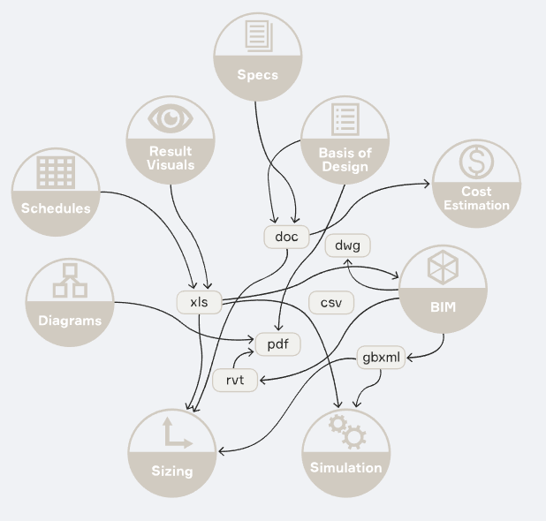
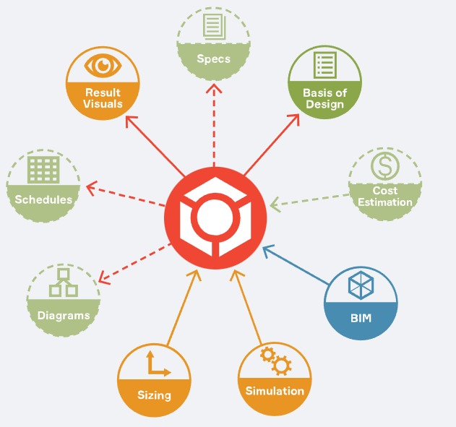
Problem - "Reduction requires Disruption"
Reducing our carbon footprint is a global issue, yet reduction requires disruption specifically around leveraging data. Coordinating data from multiple disciplines and vendors is a critical component in solving the problem, however, current forms (files) are outdated and need modernization. We need a way to focus on the right data, for the right people, at the right time.
Business as usual
Data at the center

Slide 5
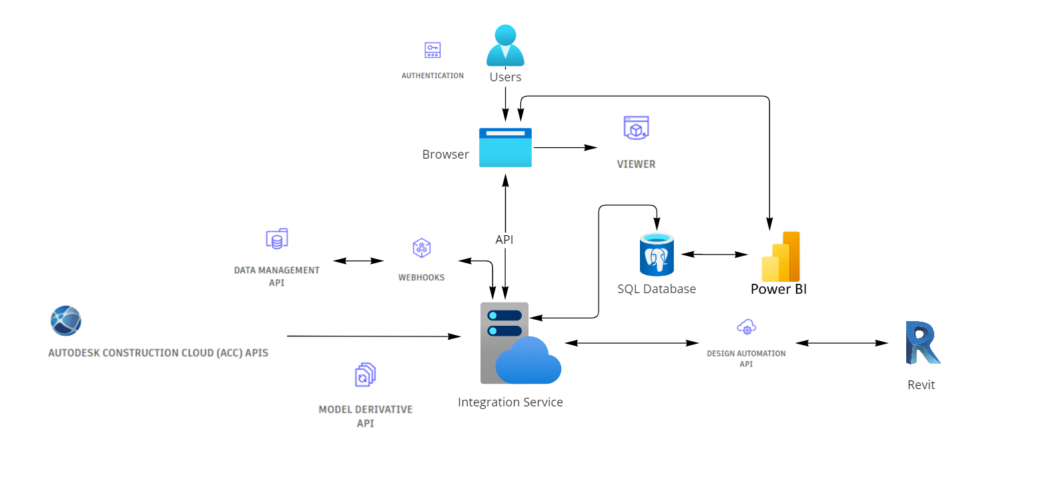
How do we solve this challenge?
Think outside the box with FORGE APIs

Slide 6
Business Model
Offer a free tool to calculate a building's carbon footprint and solar potential that is integrated with Revit models
Step up to premium services to calculate other factors with the same technology stack with per user subscription;
HVAC Loads
Daylighting
Energy Simulation
Optimization using ML/AI with enough data collected

Slide 7
Demo
Demo Video
Submission Guidelines:
1 min MAX
Intro (include team name)
Challenge attempted
Problem solved
Quick demo
Video resolution:
1080p 16:19
1920x1080
Web application to extract data and calculate carbon footprint.
Notes:
In 1-2 line description of demo, please focus on problem solved.
Demo video submission guidelines:
Submission Guidelines:
1 min MAX
Intro (include team name)
Challenge attempted
Problem solved
Quick demo

